Slide 1
KOSS TASK
Tanishq Choudhary
21CS10070

Slide 2


Database Management System
Database Management System: The software which is used to manage database is called Database Management System (DBMS). For Example, MySQL, Oracle etc. are popular commercial DBMS used in different applications. DBMS allows users the following tasks:
Data Definition: It helps in creation, modification and removal of definitions that define the organization of data in database.
Data Updation: It helps in insertion, modification and deletion of the actual data in the database.
Data Retrieval: It helps in retrieval of data from the database which can be used by applications for various purposes.
User Administration: It helps in registering and monitoring users, enforcing data security, monitoring performance, maintaining data integrity, dealing with concurrency control and recovering information corrupted by unexpected failure.

Slide 3
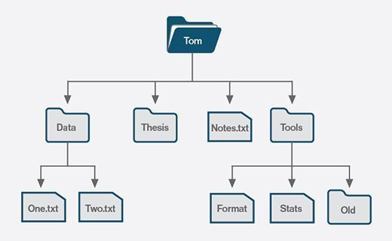
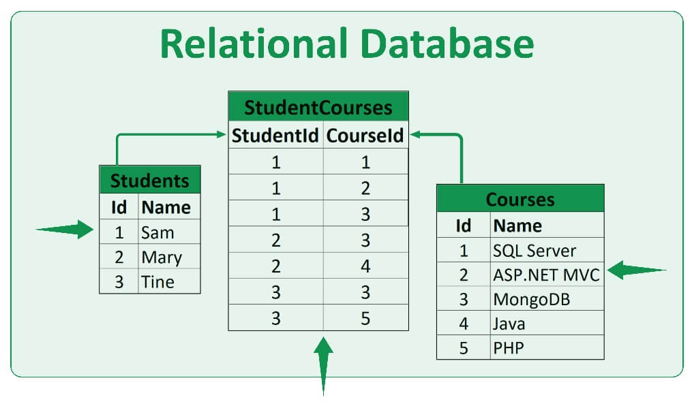
DBMS vs File system
File System manages data using files in hard disk. Users are allowed to create, delete, and update the files according to their requirement. Let us consider the example of file based University Management System. Data of students is available to their respective Departments, Academics Section, Result Section, Accounts Section, Hostel Office etc. Some of the data is common for all sections like Roll No, Name, Father Name, Address and Phone number of students but some data is available to a particular section only like Hostel allotment number which is a part of hostel office. Let us discuss the issues with this system:
Redundancy of data: Data is said to be redundant if same data is copied at many places. If a student wants to change Phone number, he has to get it updated at various sections. Similarly, old records must be deleted from all sections representing that student.
Inconsistency of Data: Data is said to be inconsistent if multiple copies of same data does not match with each other. If Phone number is different in Accounts Section and Academics Section, it will be inconsistent. Inconsistency may be because of typing errors or not updating all copies of same data.
Difficult Data Access: A user should know the exact location of file to access data, so the process is very cumbersome and tedious. If user wants to search student hostel allotment number of a student from 10000 unsorted students’ records, how difficult it can be.
Unauthorized Access: File System may lead to unauthorized access to data. If a student gets access to file having his marks, he can change it in unauthorized way.
No Concurrent Access: The access of same data by multiple users at same time is known as concurrency. File system does not allow concurrency as data can be accessed by only one user at a time.
No Backup and Recovery: File system does not incorporate any backup and recovery of data if a file is lost or corrupted.

Slide 4
Basis | File System | DBMS
Structure | The file system is software that manages and organizes the files in a storage medium within a computer. | DBMS is software for managing the database.
Data Redundancy | Redundant data can be present in a file system. | In DBMS there is no redundant data.
Backup and Recovery | It doesn’t provide backup and recovery of data if it is lost. | It provides backup and recovery of data even if it is lost.
Query processing | There is no efficient query processing in the file system. | Efficient query processing is there in DBMS.
Consistency | There is less data consistency in the file system. | There is more data consistency because of the process of normalization.
Complexity | It is less complex as compared to DBMS. | It has more complexity in handling as compared to the file system.
Example | Cobol, C++ | Oracle, SQL Server

Slide 5
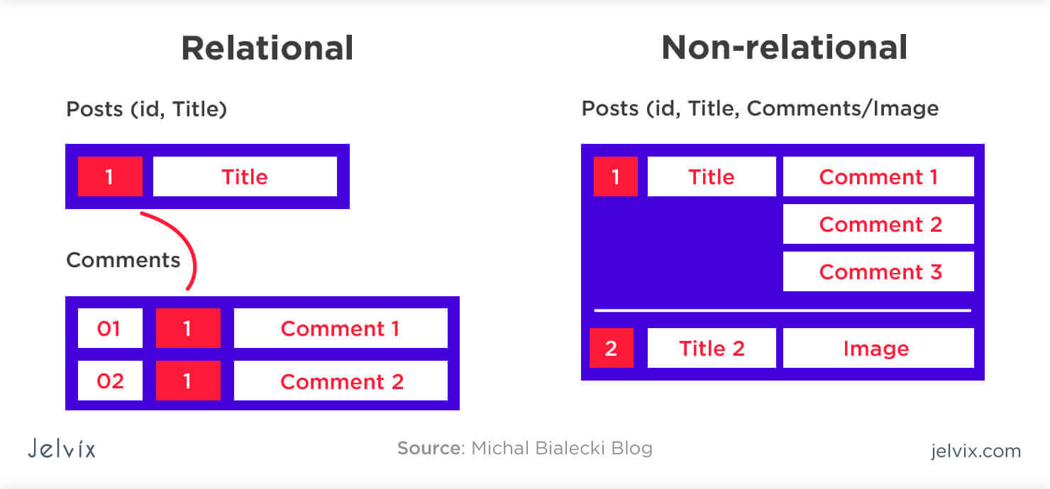
Relational vs NoSQL
SQL databases are known as relational databases, and have a table-based data structure, with a strict, predefined schema required. NoSQL databases, or non-relational databases, can be document based, graph databases, key-value pairs, or wide-column stores. NoSQL databases don’t require any predefined schema, allowing you to work more freely with “unstructured data.” Relational databases are vertically scalable, but usually more expensive, whereas the horizontal scaling nature of NoSQL databases is more cost-efficient.

Slide 6
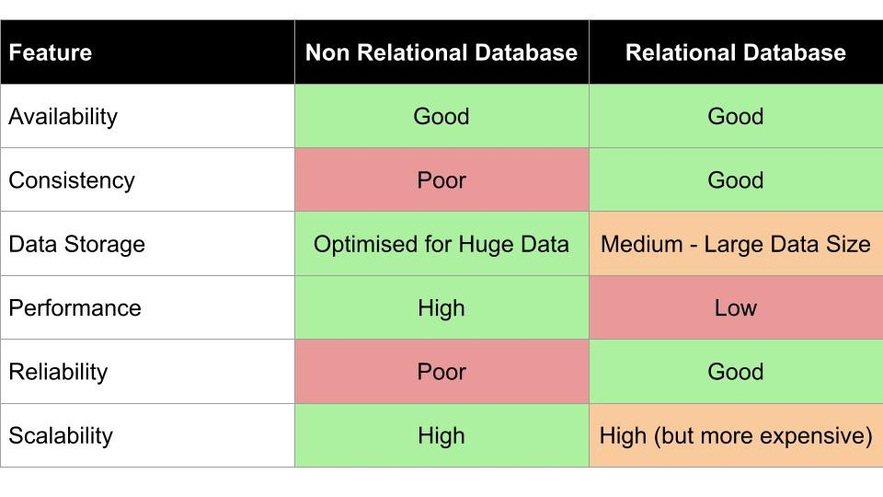
Data Models and Schema:
NoSQL databases feature dynamic schema, and allow you to use what’s known as “unstructured data.” This means you can build your application without having to first define the schema. In a relational database, you are required to define your schema before adding data to the database. Not needing a predefined schema makes NoSQL databases much easier to update as data and requirements change. Changing the schema structure in a relational database can be extremely expensive, time-consuming, and often involve downtime or service interruptions.
Data Structure:
Relational databases are table-based. NoSQL databases can be document based, graph databases, key-value pairs, or wide-column stores. Relational databases were built during a time that data was mostly structured and clearly defined by their relationships. Today, we know that data today is much more complex. NoSQL databases are designed to handle the more complex, unstructured data, (such as texts, social media posts, photos, videos, email) which increasingly make up much of the data that exists today.
Scaling:
Relational databases are vertically scalable but typically expensive. Since they require a single server to host the entire database, in order to scale, you need to buy a bigger, more expensive server. Scaling a NoSQL database is much cheaper, compared to a relational database, because you can add capacity by scaling horizontally over cheap, commodity servers.
Development Model:
NoSQL databases tend to be more a part of the open-source community. Relational databases are typically closed source with licensing fees baked into the use of their software.
Application:
NoSQL is used for Big data and real-time web apps. For example, companies like Twitter, Facebook and Google collect terabytes of user data every single day. Whereas SQL databases provide great benefits for transactional data whose structure doesn’t change frequently (or at all) and where data integrity is paramount. It’s also best for fast analytical queries. Examples include AWS, Microsoft Azure, Google Cloud Platform.

Slide 7
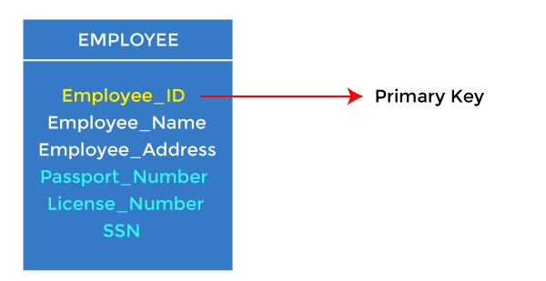
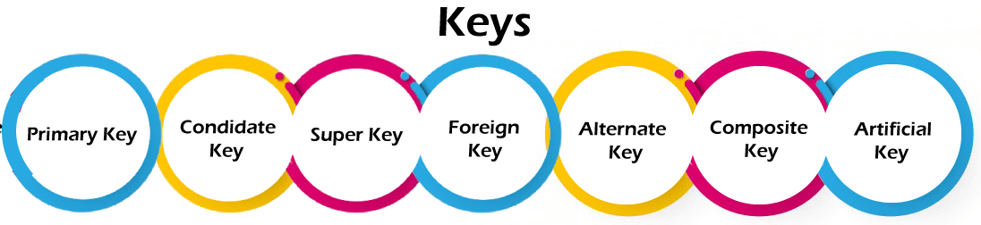
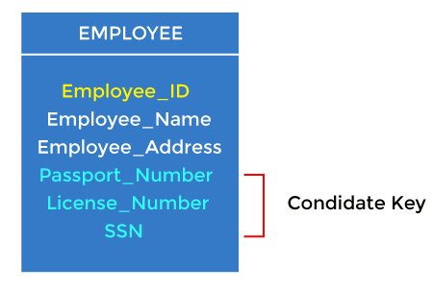
Types of Keys
Primary key
It is the first key used to identify one and only one instance of an entity uniquely. An entity can contain multiple keys, as we saw in the PERSON table. The key which is most suitable from those lists becomes a primary key.
In the EMPLOYEE table, ID can be the primary key since it is unique for each employee. In the EMPLOYEE table, we can even select License_Number and Passport_Number as primary keys since they are also unique.
For each entity, the primary key selection is based on requirements and developers.
Candidate key
A candidate key is an attribute or set of attributes that can uniquely identify a tuple.
Except for the primary key, the remaining attributes are considered a candidate key. The candidate keys are as strong as the primary key.
For example: In the EMPLOYEE table, id is best suited for the primary key. The rest of the attributes, like SSN, Passport_Number, License_Number, etc., are considered a candidate key.

Slide 8
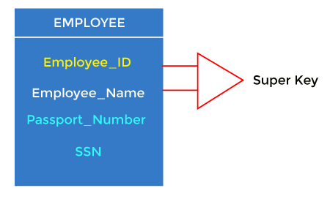
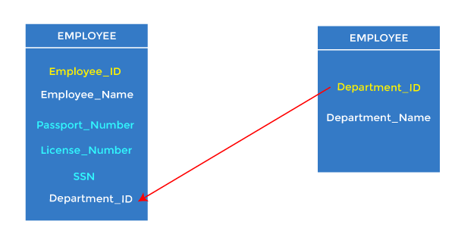
Super Key
Super key is an attribute set that can uniquely identify a tuple. A super key is a superset of a candidate key.
For example: In the above EMPLOYEE table, for(EMPLOEE_ID, EMPLOYEE_NAME), the name of two employees can be the same, but their EMPLYEE_ID can't be the same. Hence, this combination can also be a key.
Foreign key
Foreign keys are the column of the table used to point to the primary key of another table.
Every employee works in a specific department in a company, and employee and department are two different entities. So we can't store the department's information in the employee table. That's why we link these two tables through the primary key of one table.
We add the primary key of the DEPARTMENT table, Department_Id, as a new attribute in the EMPLOYEE table.
In the EMPLOYEE table, Department_Id is the foreign key, and both the tables are related.

Slide 9
Alternate key
There may be one or more attributes or a combination of attributes that uniquely identify each tuple in a relation. These attributes or combinations of the attributes are called the candidate keys. One key is chosen as the primary key from these candidate keys, and the remaining candidate key, if it exists, is termed the alternate key. In other words, the total number of the alternate keys is the total number of candidate keys minus the primary key. The alternate key may or may not exist. If there is only one candidate key in a relation, it does not have an alternate key.
For example, employee relation has two attributes, Employee_Id and PAN_No, that act as candidate keys. In this relation, Employee_Id is chosen as the primary key, so the other candidate key, PAN_No, acts as the Alternate key.
Composite key
Whenever a primary key consists of more than one attribute, it is known as a composite key. This key is also known as Concatenated Key.
For example, in employee relations, we assume that an employee may be assigned multiple roles, and an employee may work on multiple projects simultaneously. So the primary key will be composed of all three attributes, namely Emp_ID, Emp_role, and Proj_ID in combination. So these attributes act as a composite key since the primary key comprises more than one attribute.
Artificial key
The key created using arbitrarily assigned data are known as artificial keys. These keys are created when a primary key is large and complex and has no relationship with many other relations. The data values of the artificial keys are usually numbered in a serial order.
For example, the primary key, which is composed of Emp_ID, Emp_role, and Proj_ID, is large in employee relations. So it would be better to add a new virtual attribute to identify each tuple in the relation uniquely.

Slide 10
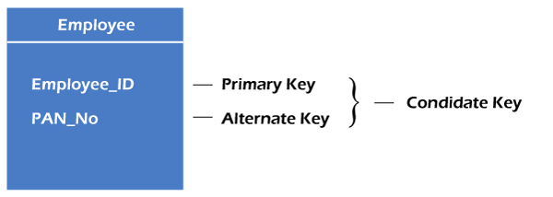
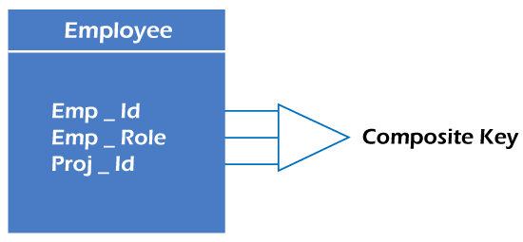
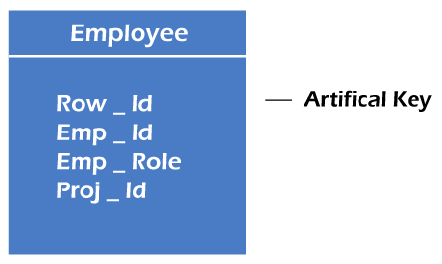

Slide 11
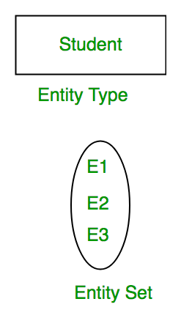
ER MODEL
ER Model is used to model the logical view of the system from data perspective which consists of these components:
Entity, Entity Type, Entity Set –
An Entity may be an object with a physical existence – a particular person, car, house, or employee – or it may be an object with a conceptual existence – a company, a job, or a university course.
An Entity is an object of Entity Type and set of all entities is called as entity set. e.g.; E1 is an entity having Entity Type Student and set of all students is called Entity Set. In ER diagram, Entity Type is represented as:
Attribute(s):
Attributes are the properties which define the entity type. For example, Roll_No, Name, DOB, Age, Address, Mobile_No are the attributes which defines entity type Student. In ER diagram, attribute is represented by an oval.

Slide 12
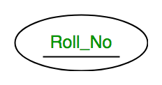
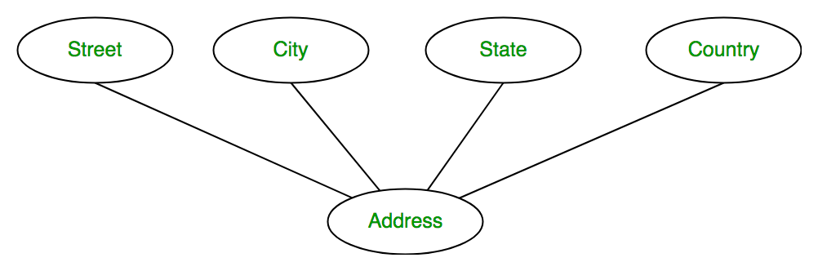
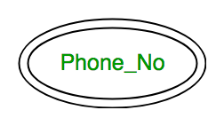
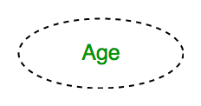
Types of Attributes
Key Attribute –
The attribute which uniquely identifies each entity in the entity set is called key attribute. For example, Roll_No will be unique for each student. In ER diagram, key attribute is represented by an oval with underlying lines.
Composite Attribute –
An attribute composed of many other attribute is called as composite attribute. For example, Address attribute of student Entity type consists of Street, City, State, and Country. In ER diagram, composite attribute is represented by an oval comprising of ovals.
Multivalued Attribute –
An attribute consisting more than one value for a given entity. For example, Phone_No (can be more than one for a given student). In ER diagram, multivalued attribute is represented by double oval.
Derived Attribute –
An attribute which can be derived from other attributes of the entity type is known as derived attribute. e.g.; Age (can be derived from DOB). In ER diagram, derived attribute is represented by dashed oval.

Slide 13
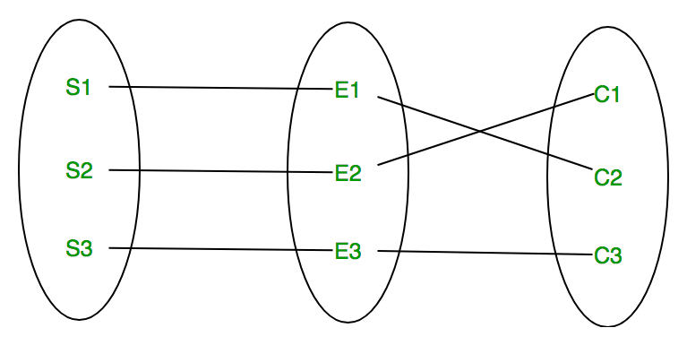

Different Types of Relationships
A relationship type represents the association between entity types. For example,‘Enrolled in’ is a relationship type that exists between entity type Student and Course. In ER diagram, relationship type is represented by a diamond and connecting the entities with lines.
A set of relationships of same type is known as relationship set. The following relationship set depicts S1 is enrolled in C2, S2 is enrolled in C1 and S3 is enrolled in C3.

Slide 14
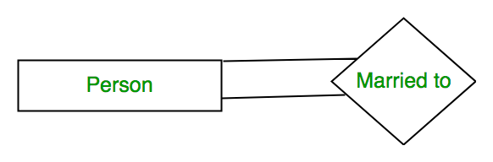
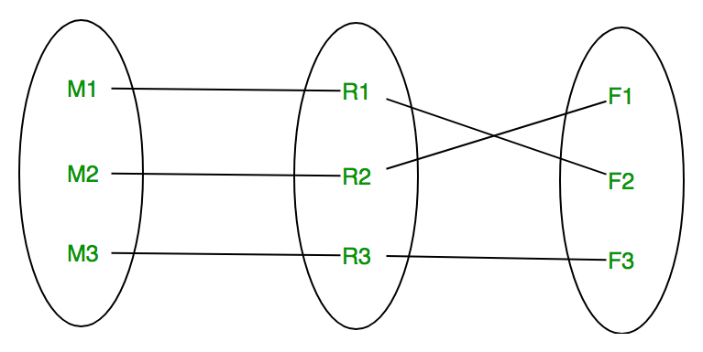
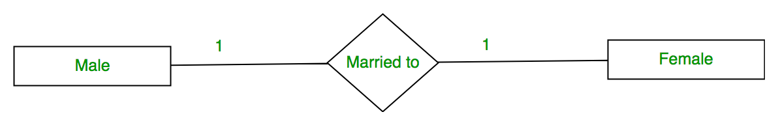
Degrees of relationship set:
Unary Relationship –
When there is only ONE entity set participating in a relation, the relationship is called as unary relationship. For example, one person is married to only one person.
Binary Relationship –
When there are TWO entities set participating in a relation, the relationship is called as binary relationship.For example, Student is enrolled in Course.

Slide 15

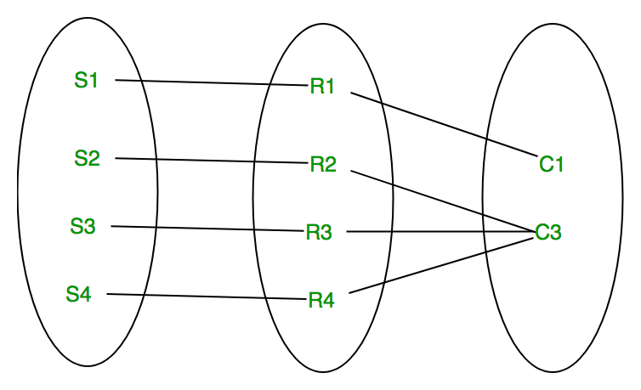
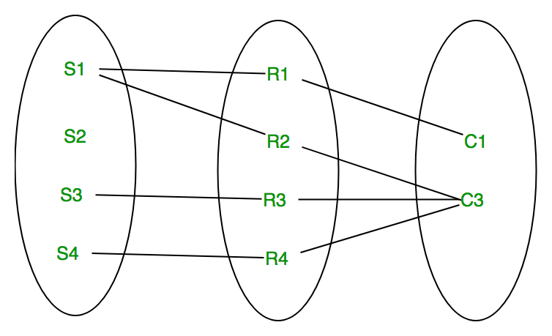

n-ary Relationship –
When there are n entities set participating in a relation, the relationship is called as n-ary relationship.
Cardinality:
The number of times an entity of an entity set participates in a relationship set is known as cardinality. Cardinality can be of different types:
One to one – When each entity in each entity set can take part only once in the relationship, the cardinality is one to one. Let us assume that a male can marry to one female and a female can marry to one male. So the relationship will be one to one.
Many to one – When entities in one entity set can take part only once in the relationship set and entities in other entity set can take part more than once in the relationship set, cardinality is many to one. Let us assume that a student can take only one course but one course can be taken by many students. So the cardinality will be n to 1. It means that for one course there can be n students but for one student, there will be only one course.
Many to many – When entities in all entity sets can take part more than once in the relationship cardinality is many to many. Let us assume that a student can take more than one course and one course can be taken by many students. So the relationship will be many to many.

Slide 16
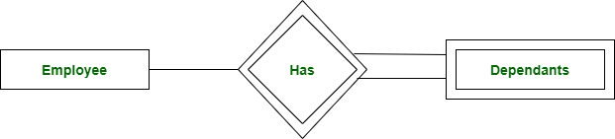
Weak Entity Type
As discussed before, an entity type has a key attribute which uniquely identifies each entity in the entity set. But there exists some entity type for which key attribute can’t be defined. These are called Weak Entity type.
For example, A company may store the information of dependents (Parents, Children, Spouse) of an Employee. But the dependents don’t have existence without the employee. So Dependent will be weak entity type and Employee will be Identifying Entity type for Dependent.
A weak entity type is represented by a double rectangle. The participation of weak entity type is always total. The relationship between weak entity type and its identifying strong entity type is called identifying relationship and it is represented by double diamond.

Slide 17
Referential Integrity
Referential integrity is a property of data stating that all its references are valid. In the context of relational databases, it requires that if a value of one attribute of a relation references a value of another attribute, then the referenced value must exist.
It refers to the relationship between tables. Because each table in a database must have a primary key, this primary key can appear in other tables because of its relationship to data within those tables

Slide 18
ER Diagram of a library database management system
The Library Management System database keeps track of readers with the following considerations –
The system keeps track of the staff with a single point authentication system comprising login Id and password.
Staff maintains the book catalog with its ISBN, Book title, price(in INR), category(novel, general, story), edition, author Number and details.
A publisher has publisher Id, Year when the book was published, and name of the book.
Readers are registered with their user_id, email, name (first name, last name), Phone no (multiple entries allowed), communication address. The staff keeps track of readers.
Readers can return/reserve books that stamps with issue date and return date. If not returned within the prescribed time period, it may have a due date too.
Staff also generate reports that has readers id, registration no of report, book no and return/issue info.
This Library ER diagram illustrates key information about the Library, including entities such as staff, readers, books, publishers, reports, and authentication system. It allows for understanding the relationships between entities.

Slide 19
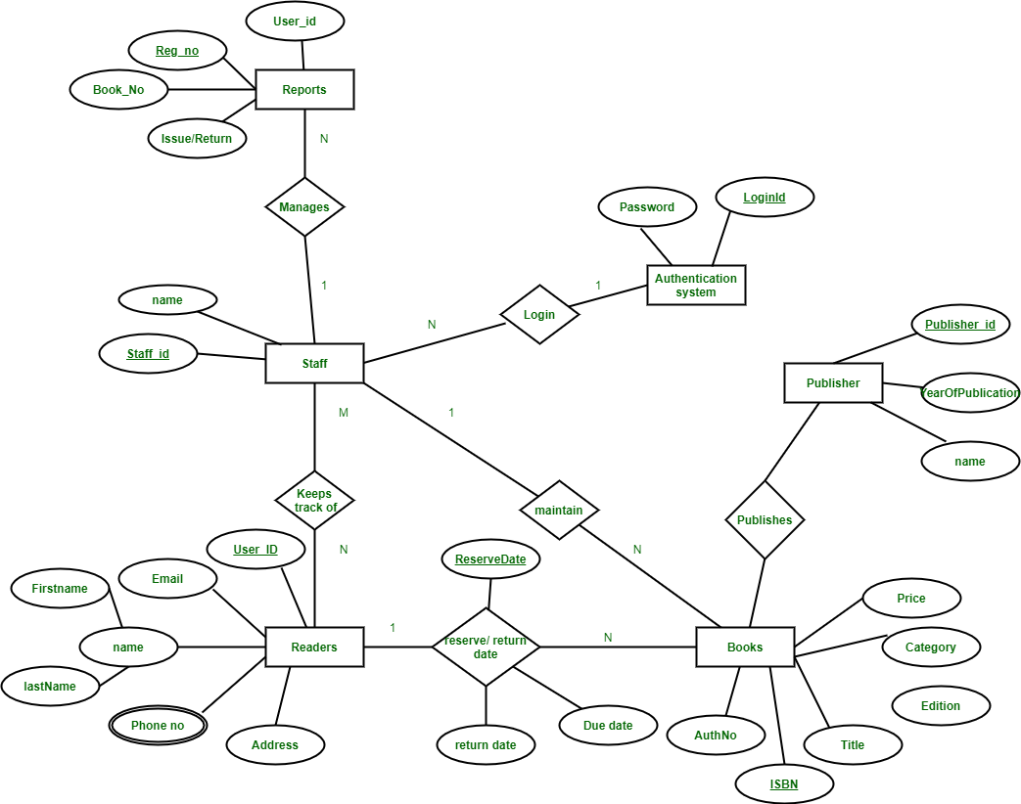

Slide 20
Normal Forms in DMBS
Normalization is the process of minimizing redundancy from a relation or set of relations. Redundancy in relation may cause insertion, deletion, and update anomalies. So, it helps to minimize the redundancy in relations. Normal forms are used to eliminate or reduce redundancy in database tables

Slide 21
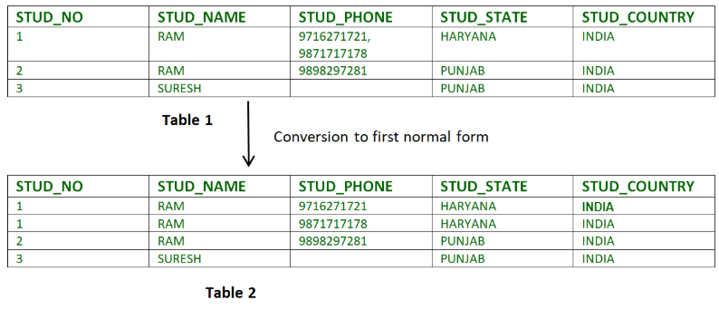
First Normal Form
If a relation contain composite or multi-valued attribute, it violates first normal form or a relation is in first normal form if it does not contain any composite or multi-valued attribute. A relation is in first normal form if every attribute in that relation is singled valued attribute.
Example 1 – Relation STUDENT in table 1 is not in 1NF because of multi-valued attribute STUD_PHONE. Its decomposition into 1NF has been shown in table 2.

Slide 22
Second Normal Form
To be in second normal form, a relation must be in first normal form and relation must not contain any partial dependency. A relation is in 2NF if it has No Partial Dependency, i.e., no non-prime attribute (attributes which are not part of any candidate key) is dependent on any proper subset of any candidate key of the table.
Partial Dependency – If the proper subset of candidate key determines non-prime attribute, it is called partial dependency.
Consider following functional dependencies in relation R (A, B , C, D )
AB -> C [A and B together determine C]
BC -> D [B and C together determine D]
In the above relation, AB is the only candidate key and there is no partial dependency, i.e., any proper subset of AB doesn’t determine any non-prime attribute.

Slide 23
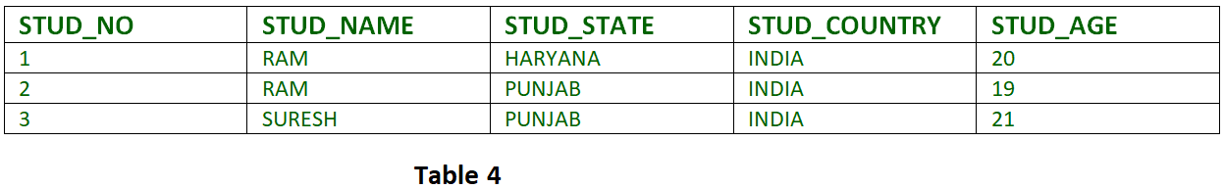
Third Normal Form
A relation is in third normal form, if there is no transitive dependency for non-prime attributes as well as it is in second normal form.
A relation is in 3NF if at least one of the following condition holds in every non-trivial function dependency X –> Y
  X is a super key.
  Y is a prime attribute (each element of Y is part of some candidate key).
Example 2 – Consider relation R(A, B, C, D, E)
A -> BC,
CD -> E,
B -> D,
E -> A
All possible candidate keys in above relation are {A, E, CD, BC} All attributes are on right sides of all functional dependencies are prime.

Slide 24
Boyce-Codd Normal Form (BCNF)
A relation R is in BCNF if R is in Third Normal Form and for every FD, LHS is super key. A relation is in BCNF iff in every non-trivial functional dependency X –> Y, X is a super key.
Example 2 –For example consider relation R(A, B, C)
A -> BC,
B ->
A and B both are super keys so above relation is in BCNF.
Key Points –
  BCNF is free from redundancy.
  If a relation is in BCNF, then 3NF is also satisfied.
  If all attributes of relation are prime attribute, then the relation is always in 3NF.
  A relation in a Relational Database is always and at least in 1NF form.
  Every Binary Relation ( a Relation with only 2 attributes ) is always in BCNF.
  If a Relation has only singleton candidate keys( i.e. every candidate key consists of only 1 attribute), then the Relation is always in 2NF( because no Partial functional dependency possible).
  Sometimes going for BCNF form may not preserve functional dependency. In that case go for BCNF only if the lost FD(s) is not required, else normalize till 3NF only.
  There are many more Normal forms that exist after BCNF, like 4NF and more. But in real world database systems it’s generally not required to go beyond BCNF.

Slide 25
SQL
SELECT - extracts data from a database
UPDATE - updates data in a database
DELETE - deletes data from a database
INSERT INTO - inserts new data into a database
CREATE DATABASE - creates a new database
ALTER DATABASE - modifies a database
CREATE TABLE - creates a new table
ALTER TABLE - modifies a table
DROP TABLE - deletes a table
CREATE INDEX - creates an index (search key)
DROP INDEX - deletes an index

Slide 26
